Slide 1
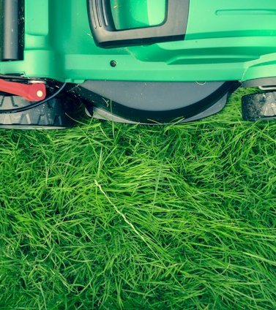


Go Electric!
an incentive program to encourage residents to shift to electric or manual lawn equipment

Slide 2

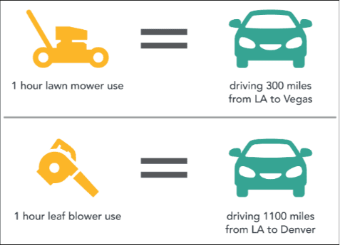
Gas Powered Lawn Equipment Harms People & The Planet
Gas-powered leaf blowers emit carbon monoxide, nitrous oxides (which cause smog and acid rain), and hydrocarbons (a carcinogenic gas that also causes smog).
  a two-stroke gasoline-powered leaf blower spews out more pollution than a 6,200-pound Ford F-150 SVT Raptor pickup truck (2011 study by Edmunds)
Gas powered leaf blowers create high levels of noise pollution.
  can emit 80-100 decibels of sound, equivalent to an airplane taking off
“Nonroad” engines, such as those used in lawn equipment, are responsible for 4 to 5 percent of total greenhouse gas emissions in the United States.
  a single gas-powered lawn mower emits as much pollution in one hour as driving a car for 45 miles (Environmental Protection Agency report)

Slide 3
Impacts in Maryland
Maryland PIRG Foundation report, called “Lawn Care Goes Electric: Why It’s Time to Switch to a New Generation of Clean, Quiet Electric Lawn Equipment” found:
“gas-powered lawn and garden equipment in Maryland emitted an estimated 597 tons of harmful “fine particulate” air pollution in 2020 — an amount equivalent to the pollution emitted by 6.4 million gas-powered cars over the course of a year.”
Prince George’s, Montgomery, Baltimore, and Anne Arundel Counties all in the top 100 Counties nationwide for fine particulate air pollution.
Reducing pollution from lawn equipment aligns with goals in Maryland’s Climate Pathway.

Slide 4

Electric and manual equipment is better
Electric lawn mowers and leaf blowers have zero emissions.
Much lower noise levels. Electric leaf blowers 60-70 decibels.
Much lower impacts on human, environmental, and animal health.
Easier maintenance and lower operating costs
Manual equipment – reel lawn mowers and rakes – provide greater exercise.

Slide 5

Municipalities are taking action
More than 100 cities ban or limit the use of gas-powered leaf blowers. Hyattsville and DC have bans on gas leaf blowers.
Several local communities are offering incentives for purchasing electric equipment.
Bowie has a successful incentive program
  Electric mowers are eligible for a $50 rebate
  Mulching or manual mowers are also eligible for a $50 rebate
  Electric weed whackers, leaf blowers, and hedge trimmers are eligible for a $25 rebate each
  If you purchase all four items (the electric mower, hedge trimmer, weed whacker, and leaf blower) you may receive a $150 rebate
  Items must be purchased after July 1, 2022. (Mulching, manual and electric mowers are eligible under the original mower rebate program and are not subject to the July 1, 2022 date)
First Step in Going Electric – easier than buying an electric vehicle or putting solar on the roof.

Slide 6

College Park: Build on Bowie’s model
Higher amounts than offered in Bowie to better incentivize the move to electric/manual:
  electric mowers or manual reel mowers: $100 rebate
  electric weed whackers, leaf blowers, and hedge trimmers: $50 rebate each
  rake: $20 rebate (up to two rakes)
  maximum household rebate: $250
Initial budget: $8,000 through June 2024 and $20,000 next year
Make it easy to submit receipts online and in person
Educate people on proper disposal of gas-powered equipment

Slide 7

Important step in the City’s Environmental goals
The Incentive Program is part of a larger effort to encourage residents to take part in greener practices:
No Mow April
Leave the Leaves
Plant Trees
Food Scrap Program/Backyard Compost
Rain Barrels

